Slide 1
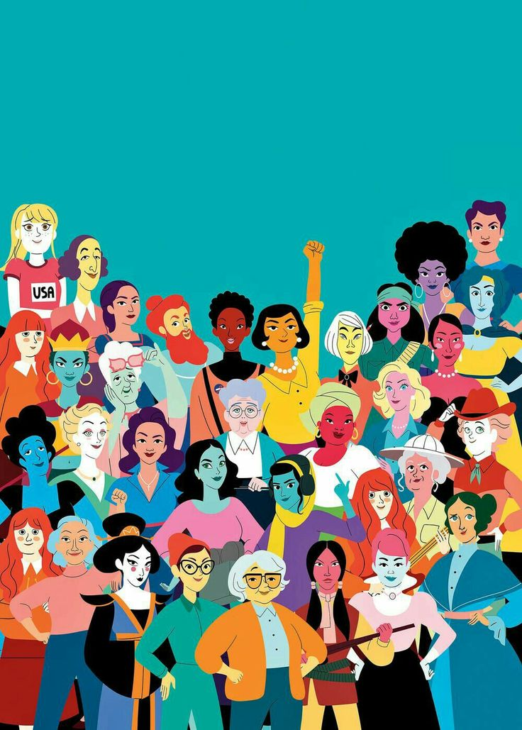
Social Factors Affecting Consumer Behavior
Presented by:
Umair Khan (SP20-BCS-011)
Muhammad Ali Khan (SP20-BCS-034)
Muhammad Anas Dar (SP20-BCS-035)
Waqas (SP20—BCS-050)

Slide 2
Consumer behavior is significantly influenced by social factors.
Social Factors
Social Factors
Groups
Family
Role
Status
Social Factors
Marketing

Slide 3
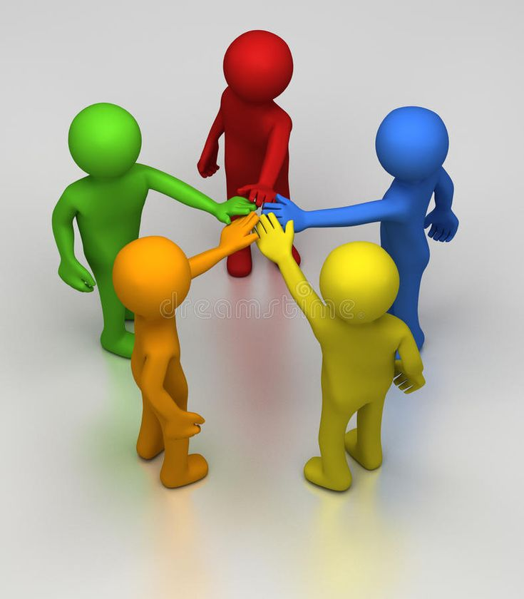
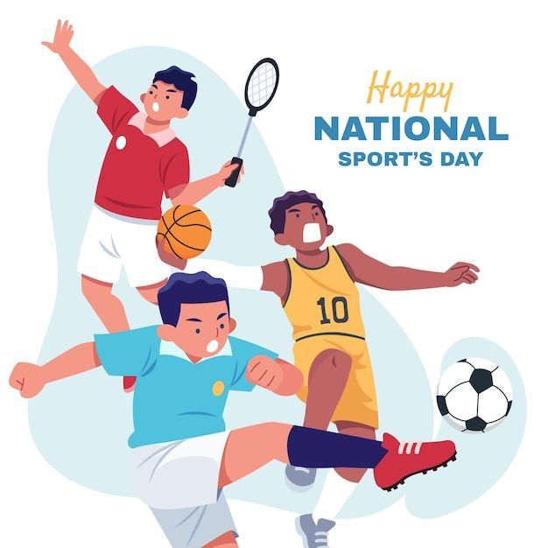
Membership Groups: Groups to which a person belongs and which have a direct influence on them.
Reference Groups: Provide a standard for influencing an individual's behavior and attitudes, often including groups one does not belong to.
Example: A young basketball player inspired by LeBron James.
Social Factors
Social Groups
Social Factors
Marketing

Slide 4
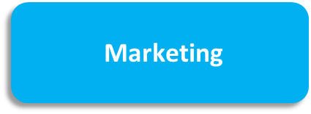
1
Upper Class: Associated with wealth and prestige.
Buy products that reflect wealth.
Social Factors
2
Middle Class: Upper And Lower Middle Class
Known for being professional and civic-minded. Buy products that reflect success ,responsibility and value for money.
Divisions in society
Social Factors
Social Classes
3
Working Class: Lifestyle-oriented.
focus on affordability and durability.
4
Lower Class: Faces economic struggles.
focuses on meeting basic needs.

Slide 5

Impact on Marketing and Brand Preferences
Marketers need to understand these social dynamics to target their products effectively. The social class of the target market can influence the type of products they're likely to buy.
Example: Luxury brands like Gucci or Louis Vuitton focus their marketing efforts on the upper classes, emphasizing exclusivity and status. In contrast, brands like Ford or Chevrolet might target middle to working-class consumers with messaging focused on reliability, affordability, and value for money.
Social Factors
Social Groups
Social Factors
Marketing

Slide 6
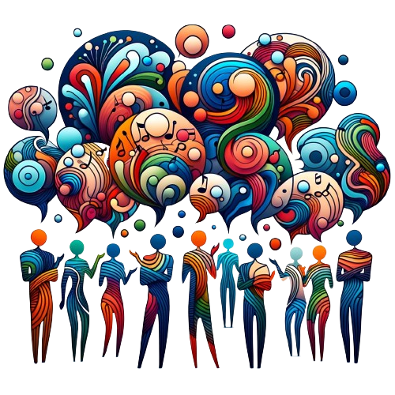
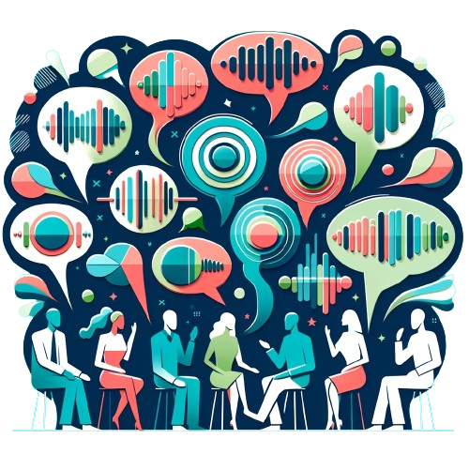
Word-of-Mouth
Word-of-Mouth
1. Powerful Impact on Buying Behavior:
Personal recommendations from friends, associates, and other consumers are often more trusted and credible than commercial advertising sources.
2. Natural Spread of Influence:
Most word-of-mouth influence occurs naturally as consumers start discussions about brands they use or feel strongly about.
3. Creating Positive Brand Conversations:.
Suggest ways in which brands can engage with consumers to encourage natural, positive word-of-mouth promotion.
Opinion Leaders
Social Factors

Slide 7
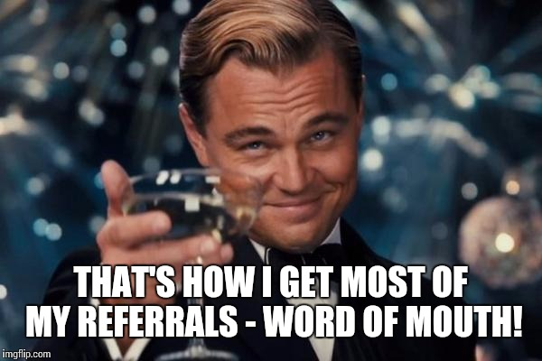
Word-of-Mouth
Opinion Leaders
Social Factors

Slide 8


The Role of Opinion Leaders in Influencing Consumer Behavior
Word-of-Mouth
Individuals within reference groups who exert significant social influence due to their special skills, knowledge, personality, or other characteristics.
Qualities that make someone an opinion leader are expertise, credibility, accessibility, and sociability.
Strategies used by marketers to engage with these opinion leaders, such as providing early access to products, invitations to exclusive events, or partnerships for content creation.
Opinion Leaders
Social Factors

Slide 9

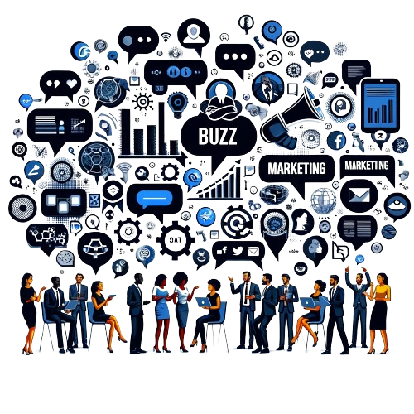
Buzz Marketing
Word-of-Mouth
Buzz marketing is a technique that focuses on creating excitement and 'buzz' about a product or brand among consumers.
It often involves leveraging opinion leaders or creating new ones to act as brand ambassadors.
Companies identify and partner with key individuals who can influence their audience about the brand’s products or services.
Opinion Leaders
Buzz Marketing

Slide 10
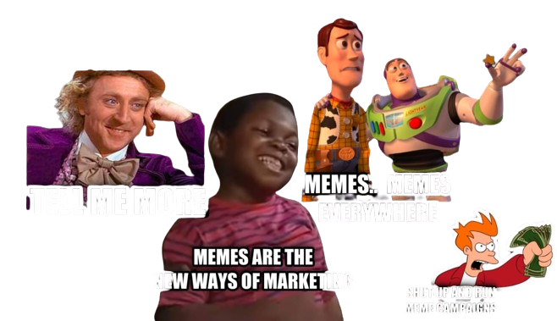
Buzz Marketing
Word-of-Mouth
Opinion Leaders
Buzz Marketing

Slide 11

Shoe Dazzle Case Stud
Combination of celebrity endorsements and customer advocacy.
Impact on brand recognition and sales.
A model for modern digital marketing strategies.
Case Study
Social Impact

Slide 12
Online Social Networks' Impact
Influencing consumer engagement and choices.
Shifting the landscape of brand promotion.
Evolution in the digital age.
Case Study
Social Impact

Slide 13
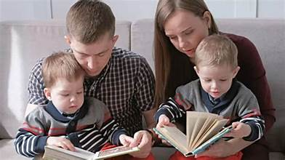
Family Dynamics in Purchasing
Influence of family roles on buying decisions.
Impact of family life cycle on consumer behavior.
Variations across different family structures.
Family Dynamic
Status

Slide 14
Roles and Status in Consumer Choices
How social and professional roles affect purchases.
Status-driven consumer behaviors.
Influence of societal norms and expectations.
Case Study
Status

Slide 15

No Questions Please!

